Slide 1
ALPhA Week 6: (2/22/19 – 3/1/19)
Gray Selby
AT-TPC Alpha – Alpha Classification

Slide 2
Week 6
After investigating further into the plots of charge traces for each pad, I manually went through each trace for Event 1 (of the events given to me) and made a .csv file holding the pad numbers of good charge spikes that make physical sense
I decided a conservative charge threshold value of 500 to filter out pads that we consider not to be a hit
Began going through pytpc documentation on github to figure out how to get pytpc installed and working to visualize events

Slide 3
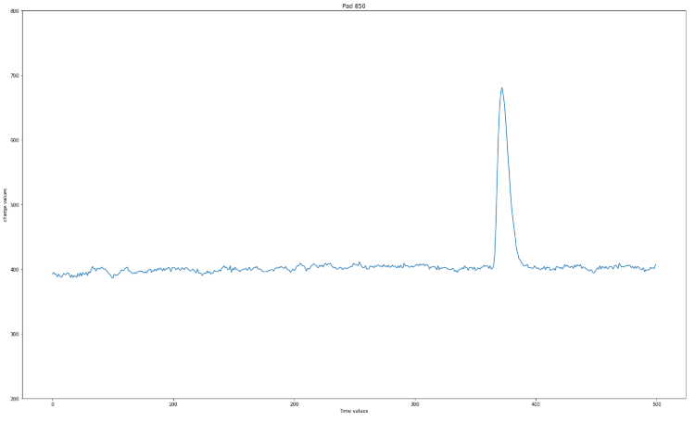
Trace of pad 850 (Event 1)
All the events manually chosen look like the trace on pad 850
Traces such as these make sense physically

Slide 4
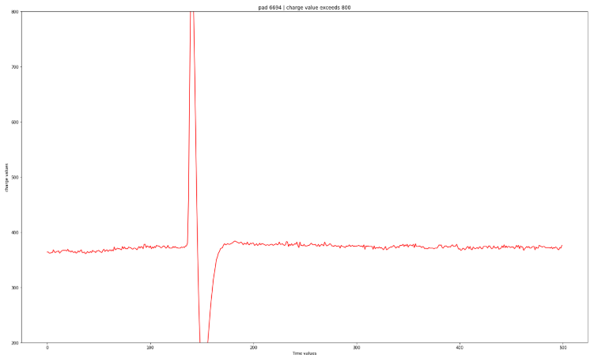
Trace of pad 6694 (Event 1)
Traces such as this for pad 6694 also make sense physically
The dip after the peak can be explained by induction

Slide 5
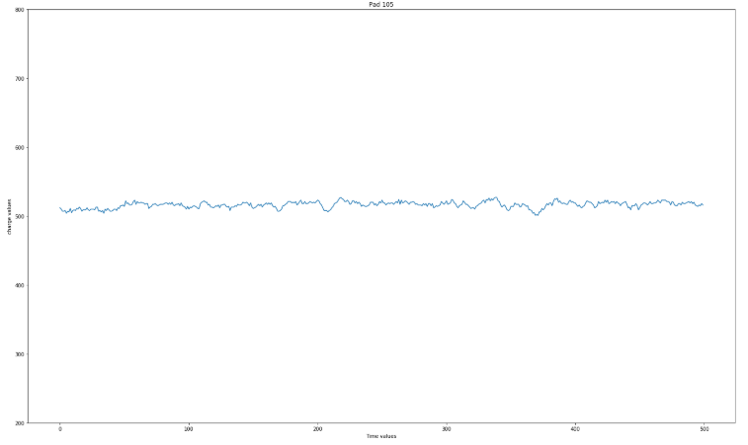
Trace of pad 105 (Event 1)
Traces like the one for pad 105 are not considered hits
The high charge value is likely due to the pad normalization by pad plane section

